Slide 1
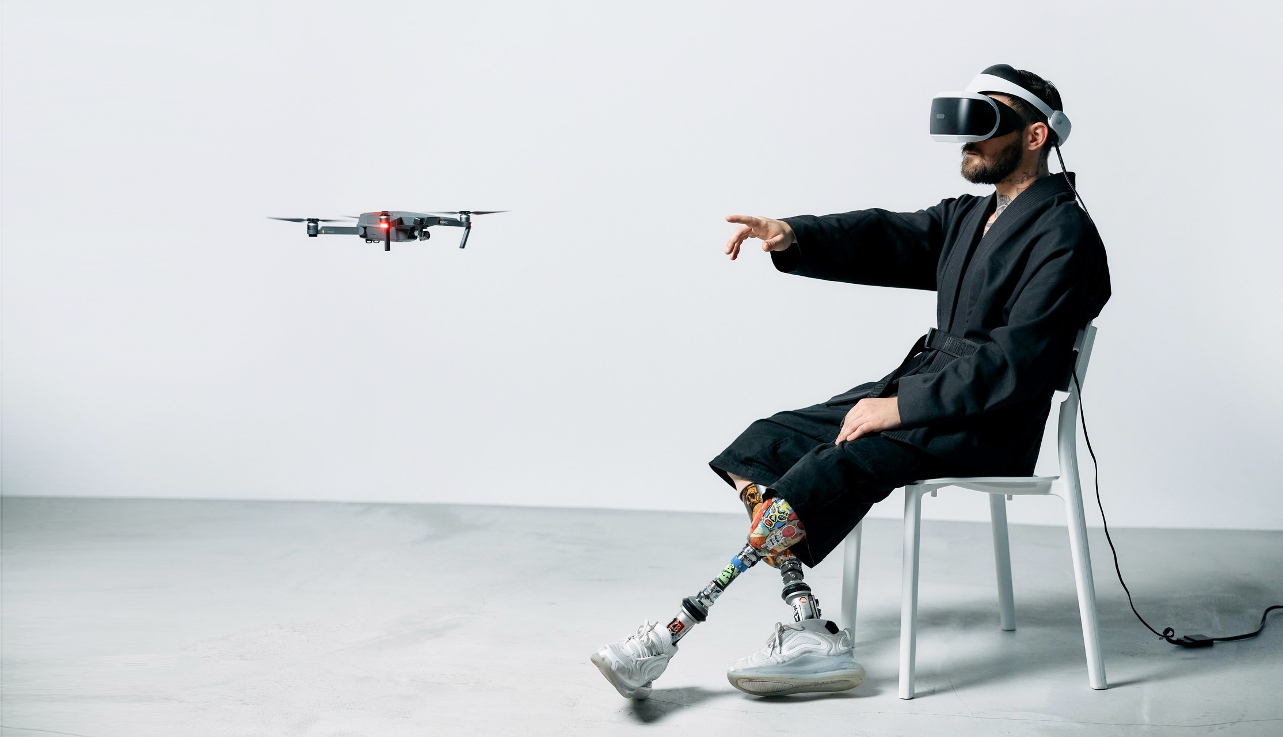


TEAM MEMBERS:
20DCE011 – Karan Bhatt
20DCE013 – Sanket Bhimani
20DCE019 – Yatharth Chauhan
DRONE
DETECTION
GUIDED BY:
Prof. Rajesh Patel
Prof. Janardan Bharvad
SEMESTER – 6 (2022-2023)

Slide 2
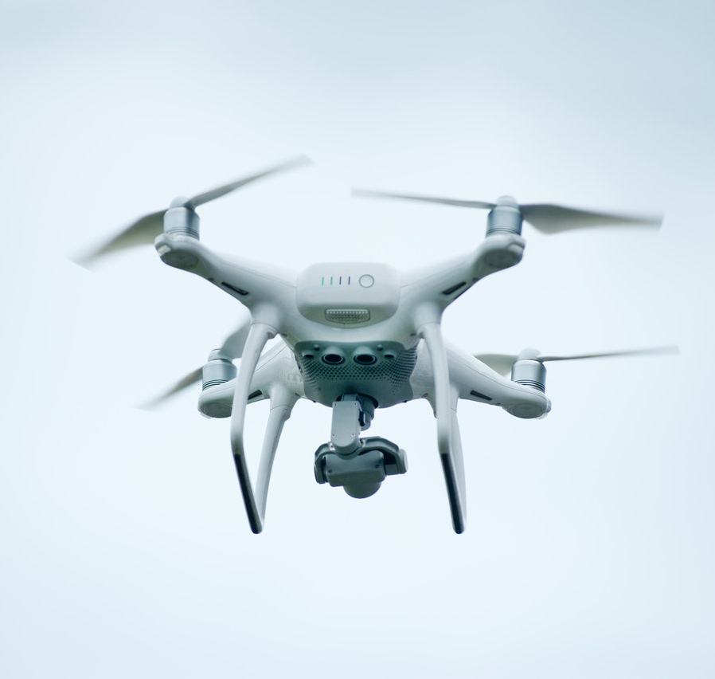
DRONE DETECTION
Contents
Introduction
Background Theory
Problem Statement
Current System and limitations
Proposed System and Scope of the System
Requirement Gathering
Hardware and Software Requirements
Project Planning (Gantt Chart)
Implementation Details
Snapshots of your system
Testing Scenarios
Demonstration
Limitations and Future Scope
Conclusion
References

Slide 3
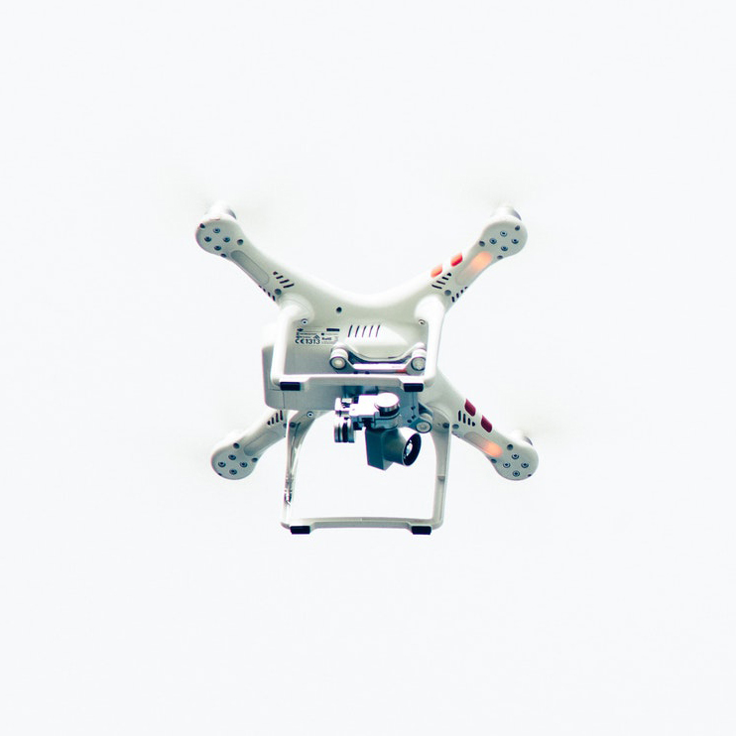
Introduction
1
The drone detection machine learning project involves the development of a system that can detect and identify drones using machine learning techniques.
The drone detection machine learning project aims to address this threat by developing a system that can detect and identify drones in real-time using machine learning algorithms.
The system can be deployed in various locations, such as airports, prisons, and government buildings, where drones are prohibited.
the drone detection machine learning system can be integrated with other security measures, such as surveillance cameras and access control systems, to provide a comprehensive security solution.

Slide 4
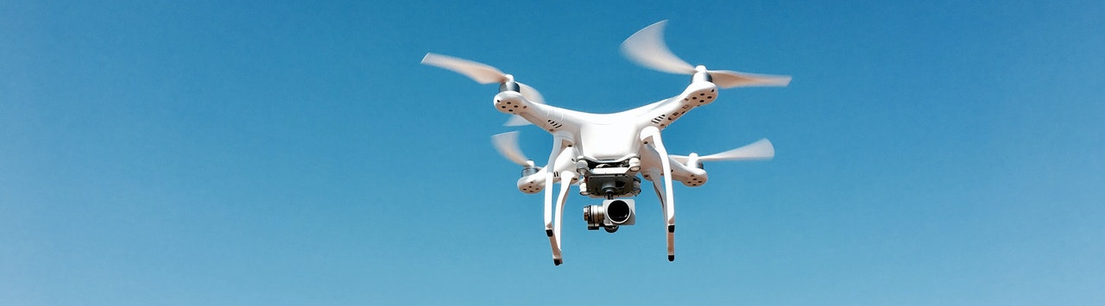
Problem Statement
Drone detection machine learning project using OpenCV aims to address the growing threat posed by drones and provide a reliable and efficient system for detecting them in real-time, contributing to public safety and security.

Slide 5
Background Theory
Drone detection is a growing concern for The ability to detect drones in real-time can help in preventing unauthorized drones from entering sensitive areas, protecting critical infrastructure, and ensuring public safety.
Drone detection machine learning project using OpenCV involves collecting and processing data, training a machine learning model, and integrating it into a real-time system for detecting drones. The success of the project depends on the quality of the training data, the selection of appropriate machine learning algorithms, and the efficient implementation of the detection system.

Slide 6
Current System and limitations
The current system for detecting drones often relies on traditional radar systems, which can be limited in their ability to detect small, low-flying drones. These systems can also be expensive, require specialized infrastructure, and may not be suitable for indoor environments.
To overcome these limitations, our drone detection machine learning project using OpenCV aims to develop a real-time system that can detect drones with high accuracy using computer vision techniques and machine learning algorithms.
However, there are also limitations to this approach. Firstly, the accuracy of the system depends on the quality of the training data used to train the machine learning model. Therefore, collecting a diverse and representative dataset of drone images and videos is essential to ensure the model can accurately distinguish between drones and other objects.

Slide 7
Proposed System and Scope of the System
Proposed System
Camera(s): High-quality cameras will be used to capture video footage and images of the scene. Computer Vision Processing: We will use OpenCV to process the video footage and images, including object detection, motion analysis, and feature extraction.
Machine Learning Model: We will train a machine learning model using supervised learning techniques to distinguish between drones and other objects in the scene.
Drone detection using OpenCV will provide a reliable and efficient system for detecting drones in real-time, contributing to public safety and security.
Scope of the System
The system will be scalable and adaptable to different use cases, including securing sensitive areas, detecting and preventing illegal drone activity in public spaces, and assisting law enforcement in identifying and apprehending drone operators who violate regulations.
The system will be able to detect drones of various sizes and types, including multirotor and fixed-wing drones.
The system will be able to distinguish between drones and other objects in the scene, such as birds, planes, and balloons.

Slide 8
Requirement Gathering
Understand the problem statement: The first step in gathering requirements for the project is to understand the problem statement. In this case, the problem is to detect drones in real-time using computer vision techniques.
Define the project scope: It is important to define the scope of the project, which includes the features and functionalities that the system should provide. This may include real-time detection, accuracy, and the ability to differentiate between drones and other objects in the scene.
Determine the dataset requirements and appropriate machine learning algorithm then determine the hardware requirements after that start implementation.

Slide 9
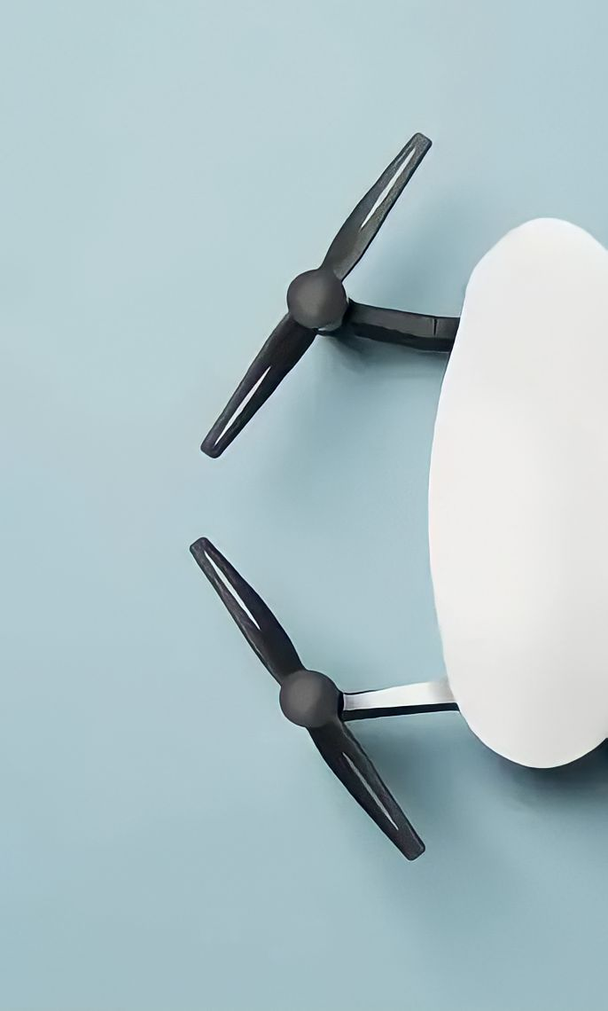
Hardware and Software Requirements
1
Hardware Requirements:
Computer with at least 8 GB of RAM.
CPU with multiple cores.
GPU with CUDA support (optional but recommended for faster processing).
USB camera or IP camera for capturing video.
Software Requirements:
Python 3.x (recommended version 3.6 or higher).
OpenCV library (recommended version 4.5 or higher).
Scikit-learn library (recommended version 0.24 or higher).
Tensorflow library (recommended version 2.4 or higher).
YOLOv5 library.

Slide 10
Gantt Chart
Research and Analysis
December
January
February
March
April
Dataset
December
January
February
March
April
Implementing
December
January
February
March
April
Testing
December
January
February
March
April

Slide 11
Testing Scenarios
Test with different drone models: Test the accuracy of the drone detection model by using images of different drone models. This will ensure that the model can detect all types of drones.
Test with different lighting conditions: Test the model under different lighting conditions, including low light, bright sunlight, and indoor lighting. This will ensure that the model can detect drones in different environments.
Test with different backgrounds: Test the model under different backgrounds, including cluttered backgrounds, plain backgrounds, and natural backgrounds such as sky or trees. This will ensure that the model can detect drones in various scenarios.
Test with videos: Test the model with videos that contain drones flying at different speeds and altitudes. This will ensure that the model can detect drones in real-time scenarios.

Slide 12
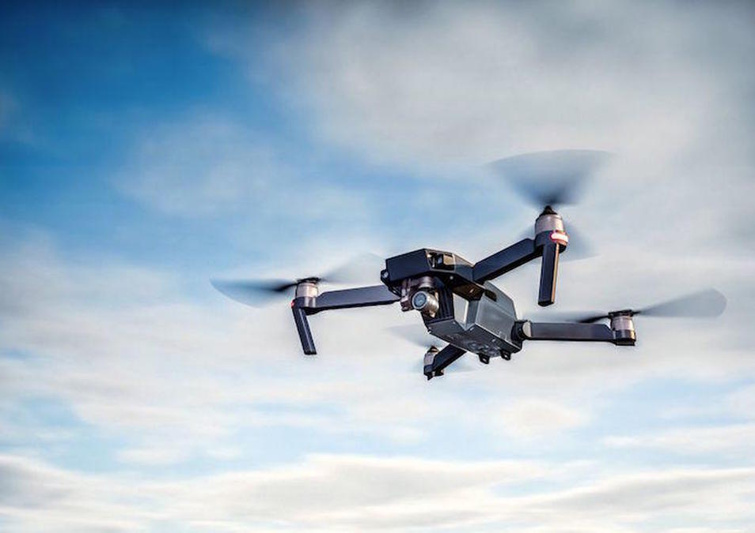
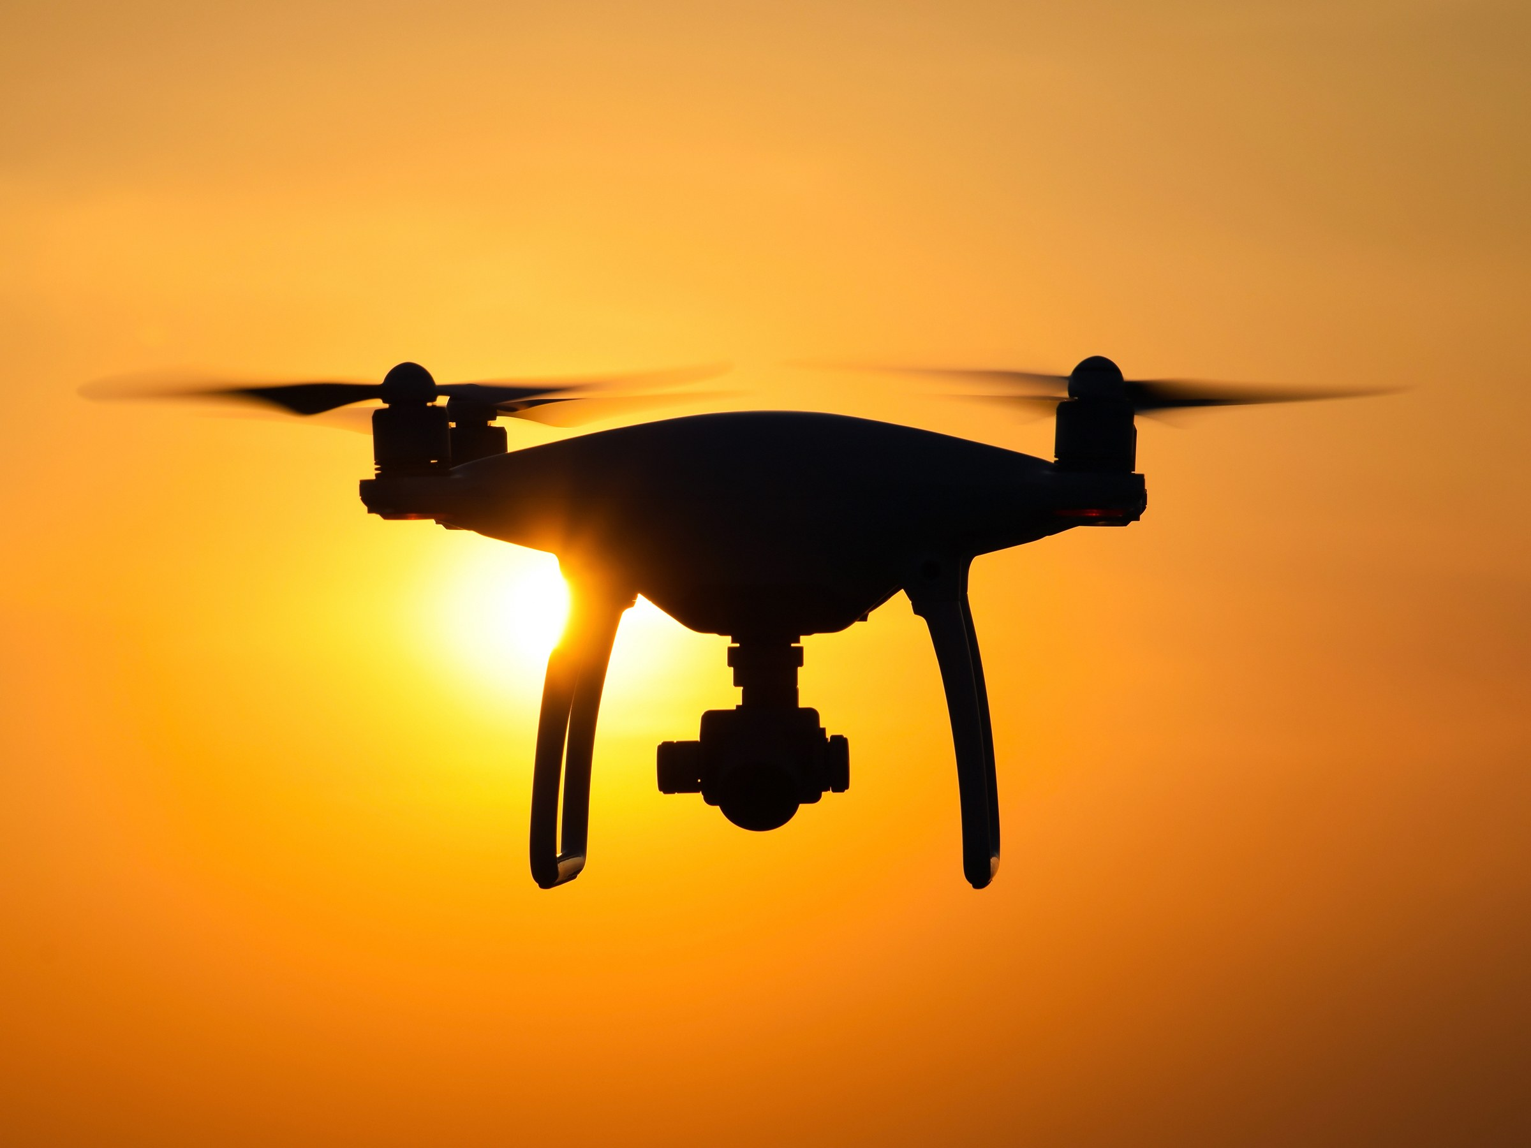
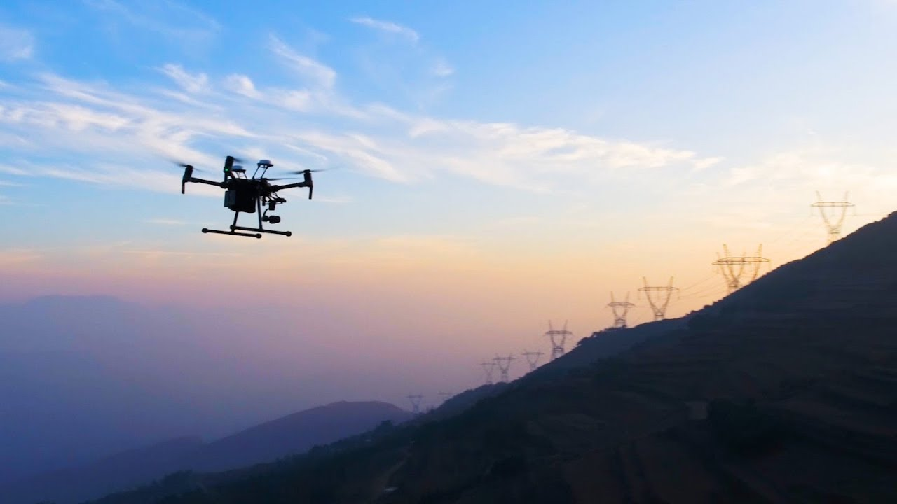
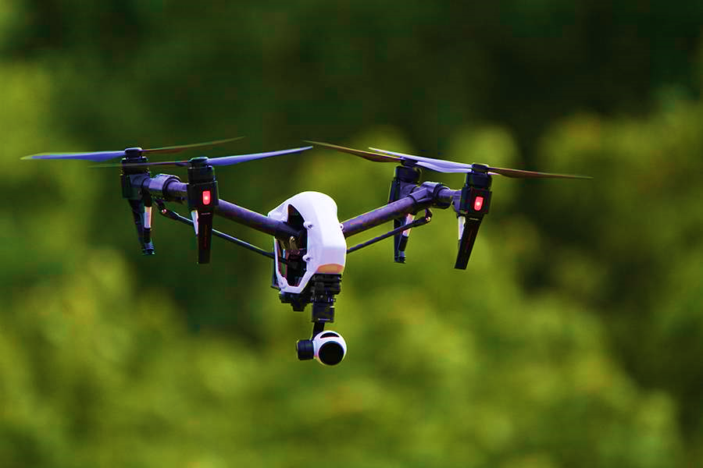
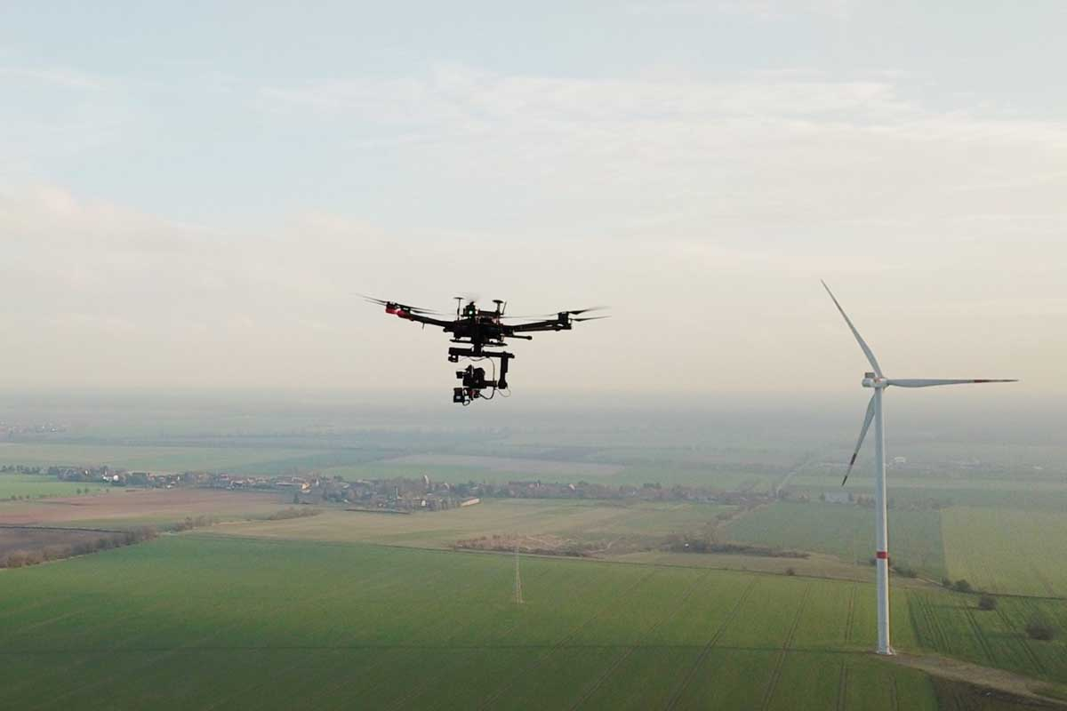
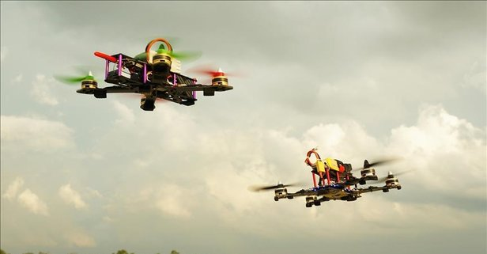
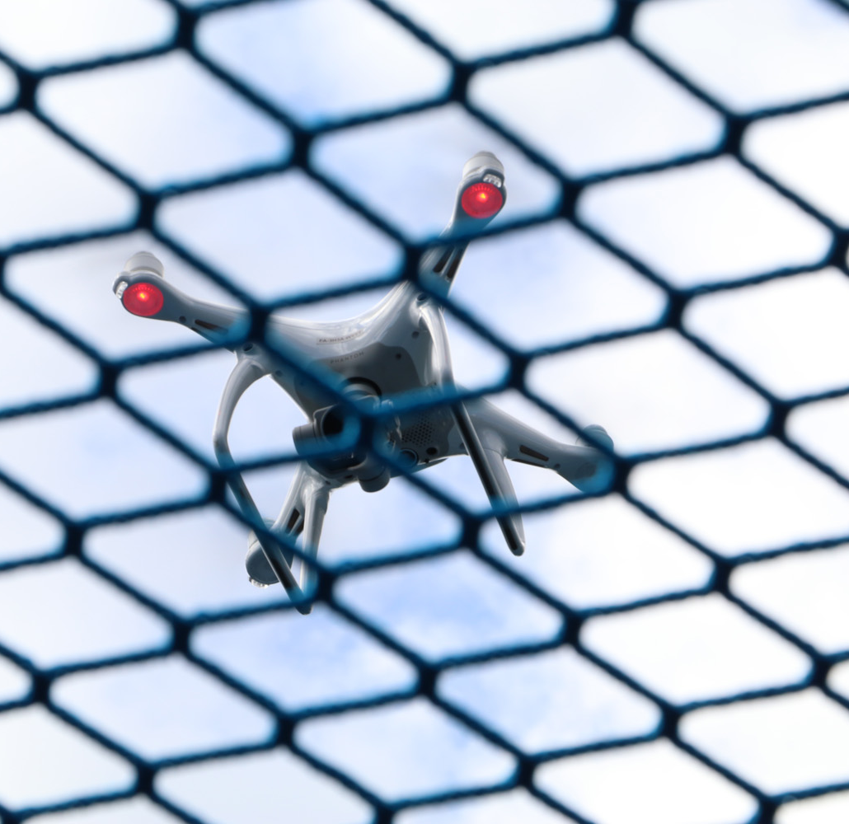
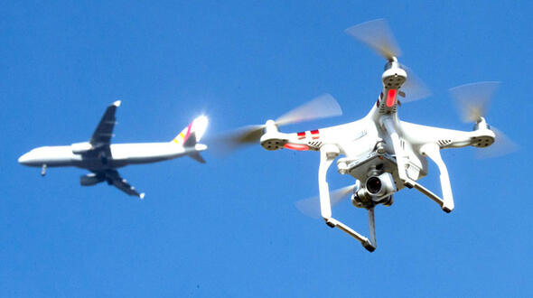
Dataset
Training
Validation

Slide 13

Demonstrations

Slide 14
Future Scope
Security and surveillance: Drone detection systems can be used to detect drones that are flying in restricted or sensitive areas, such as airports, military bases, and government buildings.
Privacy protection: Drone detection systems can be used to protect the privacy of individuals by detecting drones that are being used for unauthorized surveillance.
Agriculture: Drone detection systems can be used to detect drones that are flying over farmlands and can help in preventing crop damage and theft.
Logistics: Drone detection systems can be used to detect drones that are being used for smuggling or illegal transport of goods.

Slide 15
Conclusion
In general, the goal of such a project would be to use machine learning algorithms and computer vision techniques to detect and track drones in video footage or live camera feeds. OpenCV is a powerful tool for image processing and analysis, and it can be used to build a custom detection system that can recognize drones based on their visual characteristics.
Once the model is trained, you can use it to detect and track drones in real-time video streams. This could be useful in a variety of applications, such as border security, military operations, or civilian drone management.
Overall, a drone detection machine learning project using OpenCV can be a complex and challenging task, but it has the potential to be highly effective in improving safety and security in a variety of settings.

Slide 16
References
Drone Detection using Deep Learning and OpenCV" by Harsh Agrawal: https://www.analyticsvidhya.com/blog/2018/10/a-step-by-step-introduction-to-the-basic-object-detection-algorithms-part-1/"Drone detection with OpenCV" by Konstantinos Mamouras: https://www.pyimagesearch.com/2018/07/23/simple-object-tracking-with-opencv/“
Real-Time Drone Detection using OpenCV in Python" by Rishabh Saxena: https://towardsdatascience.com/real-time-drone-detection-using-opencv-in-python-905e10368d4c
Drone Detection and Tracking using OpenCV" by Sagar Vinodababu:
https://medium.com/@sagarvinodababu/drone-detection-and-tracking-using-opencv-19d4c4b8d041”

Slide 17
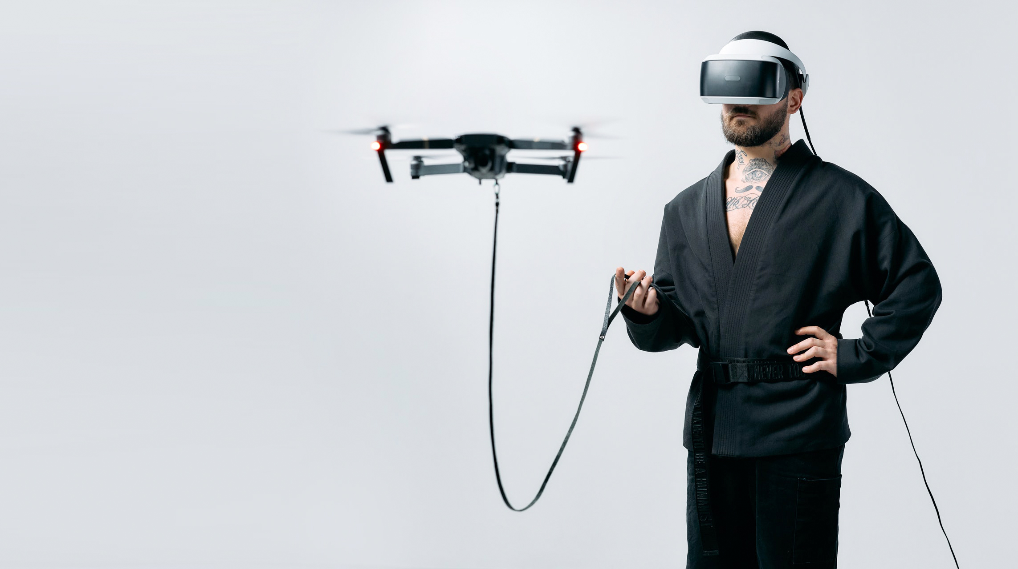
Thanks

